Slide 1

Sexual Harassment cases in Restaurant business
Name: Majed & Faris and Abdullah
Date:12/09/2023

Slide 2
Defining Sexual Harassment
Definition of sexual harassment-unwelcome sexual advances, requests for sexual favors, and other verbal or physical harassment of a sexual nature(Welsh, 1999)
Sexual harassment violates Title VII of the Civil Rights Act (Peirce, 1988).

Slide 3
Scope of the Problem
Statistics
Over 60% of restaurant employees experience some form of sexual harassment
80% of incidents go unreported
Contributing factors
Close interactions with customers
Alcohol consumption (Nawyn et al. 2000)
Imbalance of power

Slide 4


Common Forms of Harassment
Forms of sexual harassment restaurants may face:
Unwanted sexual jokes, (Matulewicz, K. (2015).
Lewd comments about appearance
Repeated requests for dates or sexual favors

Slide 5

Impact on Victims
Effects on victims:
Emotional distress
Difficulty concentrating
Increased absenteeism
Turnover intent

Slide 6
Bystander Intervention Tips
Manager responsibilities:
Implement clear sexual harassment policies
Train staff on policies and reporting
Take every claim seriously and investigate promptly

Slide 7
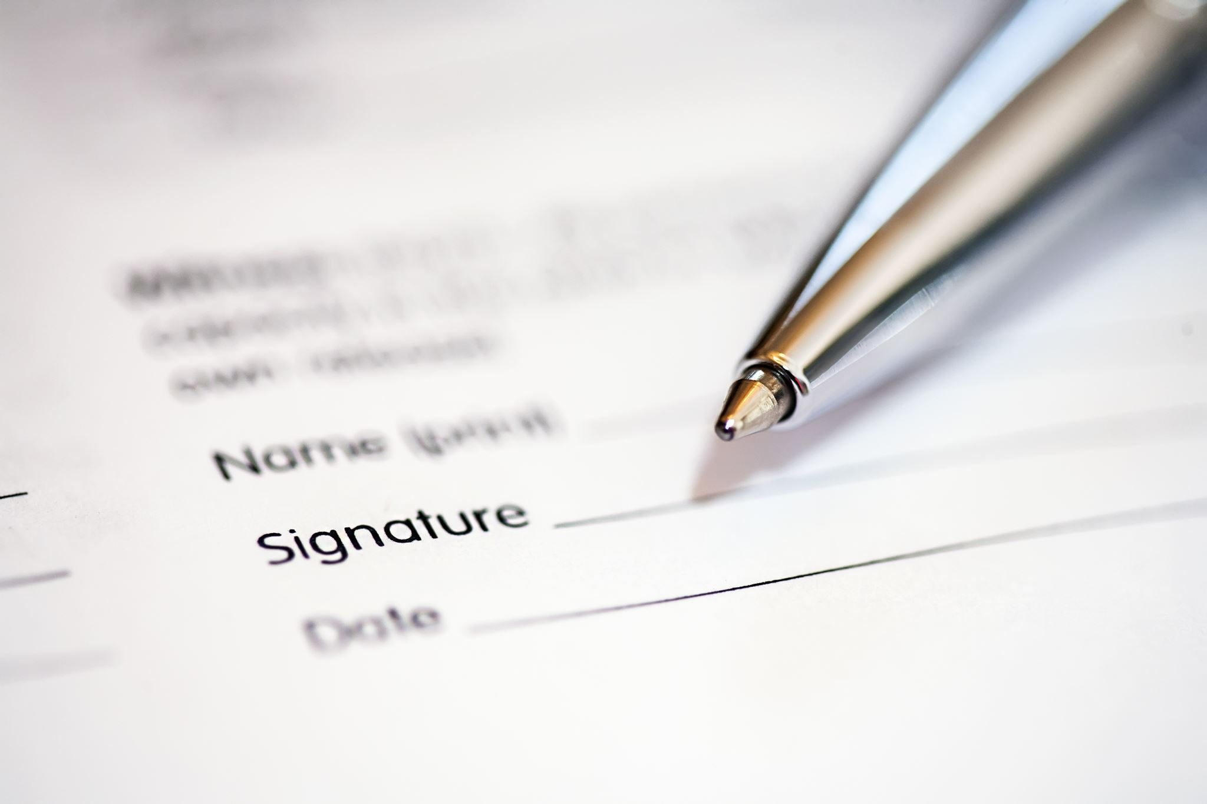
Customer Role in Solutions
Bystander intervention tips:
Direct intervention
Distract/delay
Delegate to management
Document incident

Slide 8

Effective Policy Components
How customers can contribute to solutions:
Speak up if witness harassment
Report severe or persistent cases
Support establishments with strong policies

Slide 9
Effective sexual harassment policy components
Definition and examples of prohibited conduct
Multiple channels to report confidentially
Anti-retaliation statement
Investigating claims:
Interview all involved parties
Document all investigation steps
Weigh evidence objectively
Determine appropriate response per policies

Slide 10
The Role of Management and Leadership
Adopting a Safe and Inclusive Workplace Remedial training
Adopting a positive workplace culture
Leading by example

Slide 11
Implementing and Enforcing Comprehensive Anti-Harassment Policies
Policy Development: : These policies should define unacceptable behavior, outline reporting procedures, and establish consequences for violations
Effective Communication: This includes providing training sessions to ensure that staff understands what constitutes harassment and how to report incidents
Prompt and Fair Enforcement: Investigations should be thorough, and consequences for perpetrators should be fair and consistent, regardless of their position within the organization.

Slide 12
Protecting Employees from Customers harassment
Manager presence on floor
Video surveillance
Empower employees to set boundaries

Slide 13
Conclusion
High-Stress Work Environments
Lack of Proper Training and Education
Power Dynamics within the Restaurant Pyramid
Normalization of Inappropriate Behavior

Slide 14
Reference
Welsh, S. (1999). Gender and sexual harassment. Annual review of sociology, 25(1), 169-190.
Peirce, M. R. (1988). Sexual Harassment and Title VII--A Better Solution. BCL Rev., 30, 1071.
Nawyn, S. J., Richman, J. A., Rospenda, K. M., & Hughes, T. L. (2000). Sexual identity and alcohol-related outcomes: Contributions of workplace harassment. Journal of Substance Abuse, 11(3), 289-304.
Matulewicz, K. (2015). Law and the construction of institutionalized sexual harassment in restaurants. Canadian Journal of Law and Society/La Revue Canadienne Droit et Société, 30(3), 401-419.

